Slide 1
Measures of Location/Central Tendency
Measures of location are designed to provide the analyst with some quantitative values of where the center, or some other location, of data is located.
It includes:
Mean of the sample
Median of the sample
Mode of the sample

Slide 2
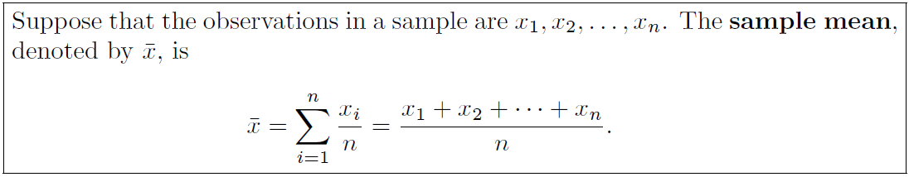
Mean of the Sample
Also called numerical average.
Sample mean is the centroid of the given data.
The trimmed mean is calculated by eliminating the highest and lowest values in the sample and taking the mean of the remaining values.
For a 10% trimmed mean, the largest 10% and the smallest 10% are eliminated.

Slide 3
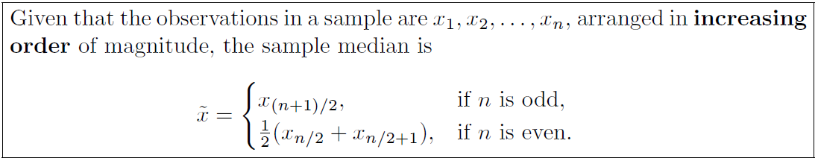
Median of the Sample
The purpose of the median is to reflect the central tendency of the sample in such a way that it is uninfluenced by extreme values or outliers.

Slide 4
Exercises
Page 13, Exercises 1.1 to 1.6

Slide 5
Mode of the sample
The value that has a higher frequency in a given set of values.
It is the value that appears the most number of times.
Example:
Consider : 2, 4, 5, 5, 6, 7
The mode of the data set is 5 since it has appeared in the set twice.

Slide 6
Mode of the sample
Bimodal:
When there are two modes in a data set, then the set is called bimodal.
For example
The mode of Set A = {2,2,2,3,4,4,5,5,5} is 2 and 5, because both 2 and 5 is repeated three times in the given set.

Slide 7
Mode of the sample
Trimodal
When there are three modes in a data set, then the set is called trimodal.
For example
The mode of set A = {2,2,2,3,4,4,5,5,5,7,8,8,8} is 2, 5 and 8
Multimodal
When there are four or more modes in a data set, then the set is called multimodal.

Slide 8

Mode Examples
The following table represents the number of wickets taken by a bowler in 10 matches. Find the mode of the given set of data.
Notes:
It can be seen that 2 wickets were taken by the bowler frequently in different matches. Hence, the mode of the given data is 2.

Slide 9
Mode Examples
Find the mode of the given data set: 3, 3, 6, 9, 15, 15, 15, 27, 27, 37, 48.
Find the mode of 4, 4, 4, 9, 15, 15, 15, 27, 37, 48 data set.
Find the mode of 3, 6, 9, 16, 27, 37, 48.
Notes:
Solution-1
In the following list of numbers, 3, 3, 6, 9, 15, 15, 15, 27, 27, 37, 48
15 is the mode since it is appearing more number of times in the set compared to other numbers.
Solution-2
Given: 4, 4, 4, 9, 15, 15, 15, 27, 37, 48 is the data set.
As we know, a data set or set of values can have more than one mode if more than one value occurs with equal frequency and number of time compared to the other values in the set.
Hence, here both the number 4 and 15 are modes of the set.
Solution-3
Solution: If no value or number in a data set appears more than once, then the set has no mode.
Hence, for set 3, 6, 9, 16, 27, 37, 48, there is no mode available.

Slide 10
Measures of Variability
Refers to the spread of data points within a data set.
It is a measure of how different the values in a data set are from each other.
Variability is also referred to as dispersion or scatter.
Variability can help us to understand the distribution of data.
For example, a data set with a high degree of variability will have a wider distribution than a data set with a low degree of variability.
Notes:
Bessel correction (use of n − 1 instead of n)
This method corrects the bias in the estimation of the population variance

Slide 11
Measures of Variability
There are a number of different ways to measure variability, including:
Range: The range is the difference between the highest and lowest values in a data set.
Variance: The variance is a measure of how spread out the values in a data set are from the mean.
Standard deviation: The standard deviation is the square root of the variance. It is a measure of how spread out the values in a data set are from the mean, in units of the mean.
Interquartile range (IQR): The IQR is the difference between the 75th percentile and the 25th percentile of a data set.
Notes:
Bessel correction (use of n − 1 instead of n)
This method corrects the bias in the estimation of the population variance

Slide 12
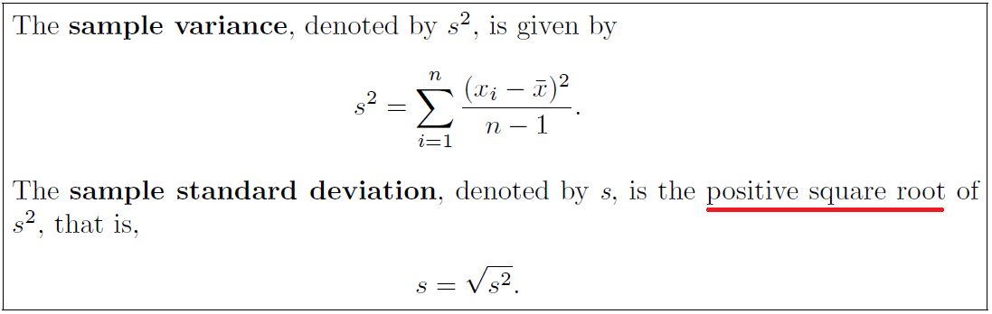
Measures of Variability
It includes:
Variance (s ² / σ²)
Standard Deviation (s / SD / σ)
Notes:
Bessel correction (use of n − 1 instead of n)
This method corrects the bias in the estimation of the population variance

Slide 13
Measures of Variability
Variance (σ²)
It measures how spread out the values in a data set are around the mean.
A large variance indicates that numbers in the set are far from the mean and from each other.
Variance can be negative.
A variance value of zero indicates that all values within a set of numbers are identical.

Slide 14
Measures of Variability
Standard Deviation (σ)
It is the measure of spread.
It is a measure of the average distance between the values of the data in the set and the mean.
The standard deviation is always a positive number and is always measured in the same units as the original data

Slide 15
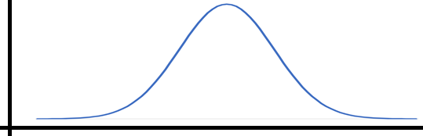
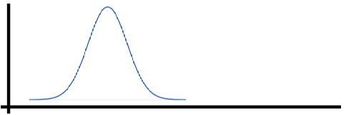
Measures of Variability
Standard Deviation (σ)
High spread data
Low spread data

Slide 16
Exercises
Page 17, Exercises 1.7 to 1.12

Slide 17
Relationship between Mean, Median and Mode
There exists an empirical relationship between mode, median and mean and this can be expressed using the formula:
Mode = 3 Median – 2 Mean

Slide 18
Statistical Modeling
Scatter Plot
Stem-and-Leaf Plot
Histograms and frequency polygons
Box-and-Whisker Plot or Box Plot

Slide 19
Scatter Plot
A scatter plot (aka scatter chart, scatter graph) uses dots to represent values for two different numeric variables.
The position of each dot on the horizontal and vertical axis indicates values for an individual data point.
Scatter plots are used to observe relationships between variables.

Slide 20
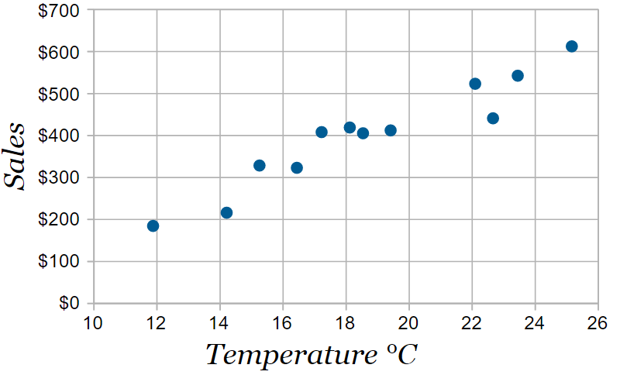
Scatter Plot
For Example:
Temperature °C | Ice Cream Sales
14.2° | $215
16.4° | $325
11.9° | $185
15.2° | $332
18.5° | $406
22.1° | $522
19.4° | $412
25.1° | $614
23.4° | $544
18.1° | $421
22.6° | $445
17.2° | $408

Slide 21
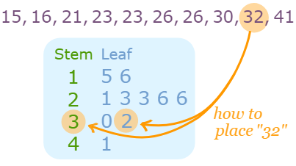
Stem-and-Leaf Plot
A Stem and Leaf Plot is a special table where each data value is split into a "stem" (the first digit or digits) and a "leaf" (usually the last digit).
For example:
Stem "1" Leaf "5" means 15
Stem "1" Leaf "6" means 16
Stem "2" Leaf "1" means 21

Slide 22
Histograms and frequency polygons
A histogram or frequency histogram, consists of a set of rectangles having bases on a horizontal axis, with centers at the class marks and lengths equal to the class interval sizes, and areas proportional to the class frequencies.
Frequency polygon is a line graph of the class frequencies plotted against class marks. It can be obtained by connecting the midpoints of the tops of the rectangles in the histogram.
Background →Frequency Distribution

Slide 23
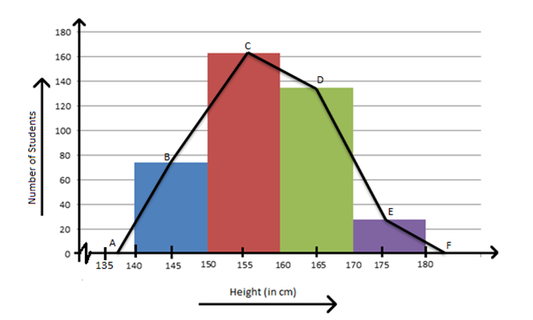
Histograms and frequency polygons
For example:

Slide 24
Frequency Distribution
Raw Data
Raw data are collected data that have not been organized numerically.
An example is the set of heights of 100 male students obtained from an alphabetical listing of university records.
Array
An array is an arrangement of raw numerical data in ascending or descending order of magnitude.
Range
The difference between the largest and smallest numbers is called the range of the data.
For example: if the largest height of 100 male students is 74 inches (in) and the smallest height is 60 in, the range
Range = 74 – 60 = 14 in.

Slide 25
Frequency Distribution
Class Frequency
When summarizing large masses of raw data, it is often useful to distribute the data into classes, or categories, and to determine the number of individuals belonging to each class, called the class frequency.
Frequency Distribution
A tabular arrangement of data by classes together with the corresponding class frequencies is called a frequency distribution, or frequency table.
No. of height of students
Height | Count
60-62 | 5
63-65 | 18
66–68 | 42
69–71 | 27
72–74 | 8

Slide 26
Frequency Distribution
Class Intervals
A symbol defining a class, such as 60–62 in table is called a class interval.
The terms class and class interval are often used interchangeably, although the class interval is actually a symbol for the class.
Class Limits
The end numbers, 60 and 62, are called class limits; the smaller number (60) is the lower class limit and the larger number (62) is the upper class limit.
Open class interval
A class interval that has either no upper class limit or no lower class limit indicated is called an open class interval.
For example, referring to age groups of individuals, the class interval ‘‘65 years and over’’ is an open class interval.

Slide 27
Frequency Distribution
Class Boundary
Class boundaries are the numbers used to separate classes. The size of the gap between classes is the difference between the upper class limit of one class and the lower class limit of the next class.
Class size, width or length
The size, or width, of a class interval is the difference between the lower and upper class boundaries and is also referred to as the class width, class size, or class length.
If all class intervals of a frequency distribution have equal widths, this common width is denoted by c.
Class mark / mid point
The class mark is the midpoint of the class interval and is obtained by adding the lower and upper class limits and dividing by 2. Thus the class mark of the interval 60–62 is (60 + 62)/2 = 61.
Notes:
https://youtu.be/TeTxqUvdB6g

Slide 28
Frequency Distribution
General rules for frequency distributions
Determine the largest and smallest numbers in the raw data and thus find the range (the difference between the largest and smallest numbers).
Divide the range into a convenient number of class intervals having the same size. If this is not feasible, use class intervals of different sizes or open class intervals.
Class intervals are also chosen so that the class marks (or midpoints) coincide with the actually observed data.
This tends to lessen the so-called grouping error involved in further mathematical analysis.
However, the class boundaries should not coincide with the actually observed data.
Determine the number of observations falling into each class interval; that is, find the class frequencies.
Notes:
https://youtu.be/TeTxqUvdB6g

Slide 29
Frequency Distribution
Relative-frequency distributions
The relative frequency of a class is the frequency of the class divided by the total frequency of all classes and is generally expressed as a percentage.
For example:
No. of height of students
Height | Count | Relative Frequency
60-62 | 5 | 5/100 = 5%
63-65 | 18 | 18/100 = 18%
66–68 | 42 | 42/100 = 42%
69–71 | 27 | 27/100 = 27%
72–74 | 8 | 8/100 = 8%
Total | 100 | 100%

Slide 30
Frequency Distribution
Relative-frequency distributions example:
Frequency Distribution of Prices for 20 Gas Stations:
Relative class distribution will be:
Gas Prices ($/Gallon) | Number of Gas Stations
$3.50–$3.74 | 6
$3.75–$3.99 | 4
$4.00–$4.24 | 5
$4.25–$4.49 | 5

Slide 31
Frequency Distribution
Cumulative Frequency Distribution
The cumulative frequency is calculated by adding each frequency from a frequency distribution table to the sum of its predecessors.
The last value will always be equal to the total for all observations, since all frequencies will already have been added to the previous total.

Slide 32
Frequency Distribution
Example: Cumulative Frequency Table (Ungrouped data)
The following table gives the frequency distribution of marks obtained by 28 students in a particular test.
Construct a cumulative frequency table for the given data.
Marks | 30 | 31 | 32 | 33
Frequency | 5 | 7 | 10 | 6
Solution:
Less Than or Equal to | Cumulative Frequency
30 | 5
31 | 5 + 7 =12
32 | 12 + 10 =22
33 | 22 + 6 =28

Slide 33
Frequency Distribution
Example: What will be the classes and total number of observations of the following data?
Height | Number of Students
Less than 59.5 | 0
Less than 62.5 | 5
Less than 65.5 | 23
Less than 68.5 | 65
Less than 71.5 | 92
Less than 74.5 | 100

Slide 34
Histograms and frequency polygons
In order to create a frequency polygon, one must follow these steps:
Creation of a histogram.
Finding the midpoints for each bar that exists on the histogram.
Placing a point on the origin of the histogram and its end.
Connection of the points.

Slide 35
Histograms and frequency polygons
Example: Construct a frequency polygon using the data given below:
Test Scores | Frequency
49.5-59.5 | 5
59.5-69.5 | 10
69.5-79.5 | 30
79.5-89.5 | 40
89.5-99.5 | 15

Slide 36
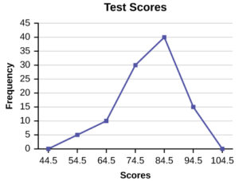
Histograms and frequency polygons
We now start by plotting the class marks such as 54.5, 64.5, 74.5 and so on till 94.5.
Note that we will also plot the previous and next class marks to start and end the polygon, i.e. we plot 44.5 and 104.5 as well.
Then, the frequencies corresponding to the class marks are plotted against each class mark.
This makes sense as the frequency for class marks 44.5 and 104.5 are zero and touching the x-axis. These plot points are used only to give a closed shape to the polygon.

Slide 37
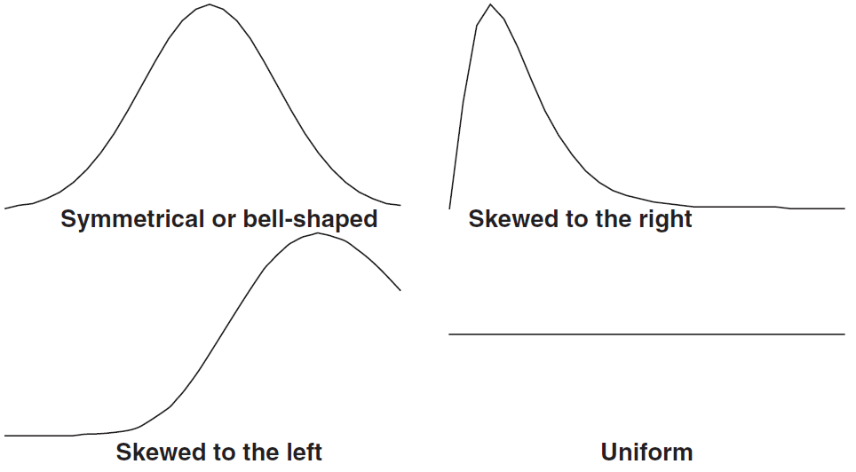
Types of frequency curves
Four common frequency distribution curves are as follows:

Slide 38
Types of frequency curves
1-Symmetrical or bell-shaped
Characterized by the fact that observations equidistant from the central maximum have the same frequency.
Example: Adult male and adult female heights have bell shaped distributions.
2-Skewed to the left
Curves that have tails to the left are said to be skewed to the left.
Example: The lifetimes of males and females are skewed to the left. A few die early in life but most live between 60 and 80 years. Generally, females live about ten years, on the average, longer than males.

Slide 39
Types of frequency curves
3-Skewed to the right
Curves that have tails to the right are said to be skewed to the right.
Example: The ages at the time of marriage of brides and grooms are skewed to the right. Most marry in their twenties and thirties but a few marry in their forties, fifties, sixties and seventies.
4-Uniform curve
Curves that have approximately equal frequencies across their values are said to be uniformly distributed.
Example: Certain machines that dispense liquid colas do so uniformly between 15.9 and 16.1 ounces.

Slide 40
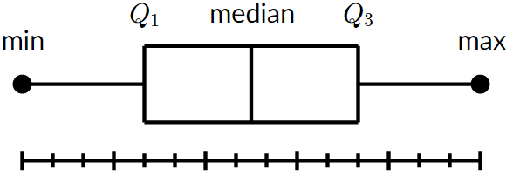
Box-and-Whisker Plot or Box Plot
A box and whisker plot—also called a box plot—displays the five-number summary of a set of data. The five-number summary is the minimum, first quartile, median, third quartile, and maximum.
In a box plot, we draw a box from the first quartile to the third quartile. A vertical line goes through the box at the median. The whiskers go from each quartile to the minimum or maximum.
Notes:
https://www.khanacademy.org/math/statistics-probability/summarizing-quantitative-data/box-whisker-plots/a/box-plot-review

Slide 41
Box-and-Whisker Plot or Box Plot
Interquartile Range (IQR)
It is the width of the box in the box-and-whisker plot.
That is, IQR = Q3 – Q1 .
The IQR can be used as a measure of how spread-out the values are.
Outliers
Statistics assumes that values are clustered around some central value.
The IQR tells how spread out the "middle" values are; it can also be used to tell when some of the other values are "too far" from the central value.
These "too far away" points are called "outliers", because they "lie outside" the range in which we expect them.
Detecting outlier
An outlier is any value that lies more than one and a half times the length of the box.
i.e. Values outside the boundary
before [Q1 - 1.5(IQR)] or after [Q3 +1.5(IQR)] will be consider as OUTLIERs.
Notes:
https://www.khanacademy.org/math/statistics-probability/summarizing-quantitative-data/box-whisker-plots/a/box-plot-review

Slide 42
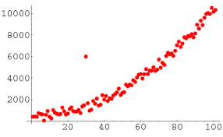
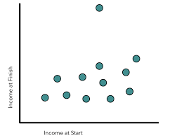
Box-and-Whisker Plot or Box Plot
Outliers

Slide 43
Box-and-Whisker Plot or Box Plot
Example: Find the outliers, if any, for the following data set:
10.2 14.1 14.4 14.4 14.4 14.5 14.5 14.6 14.7 14.7 14.7 14.9 15.1 15.9 16.4

Slide 44
Handling on grouped data
Central Tendency
Mean
Median
Mode
Variability
Variance
Standard Deviation

Slide 45
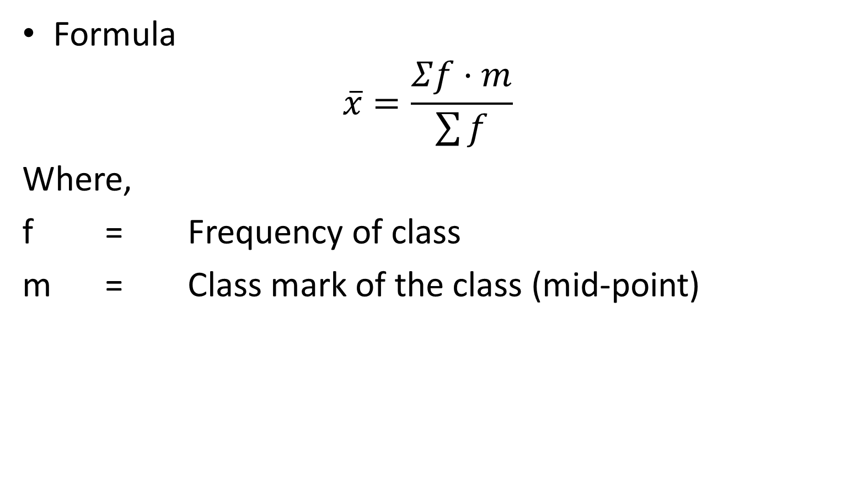
Mean of grouped data
Formula
$$\overline{x}=\frac{Σf⋅m}{\sum{f}}$$
Where,
f = Frequency of class
m = Class mark of the class (mid-point)

Slide 46
Mean of grouped data
Following table shows the grades and their frequencies obtained by the students. Obtain the mean of grade
Grades | Frequency
40-49 | 3
50-59 | 5
60-69 | 6
70-79 | 9
80-89 | 8
90-100 | 7
Mid-points
44.5
54.5
64.5
74.5
84.5
95
f.m
133.5
272.5
387
670.5
676
665

Slide 47

Mean of grouped data
Example (to do): We asked a group of people about how many hours per week they exercise, the results were as follows:
What will be the average hours per week a person exercise?
Hours/Week | Frequency
0-5 | 15
5-10 | 63
10-15 | 44
15-20 | 8
$$\overline{x}=\frac{Σf⋅m}{\sum{f}}$$

Slide 48
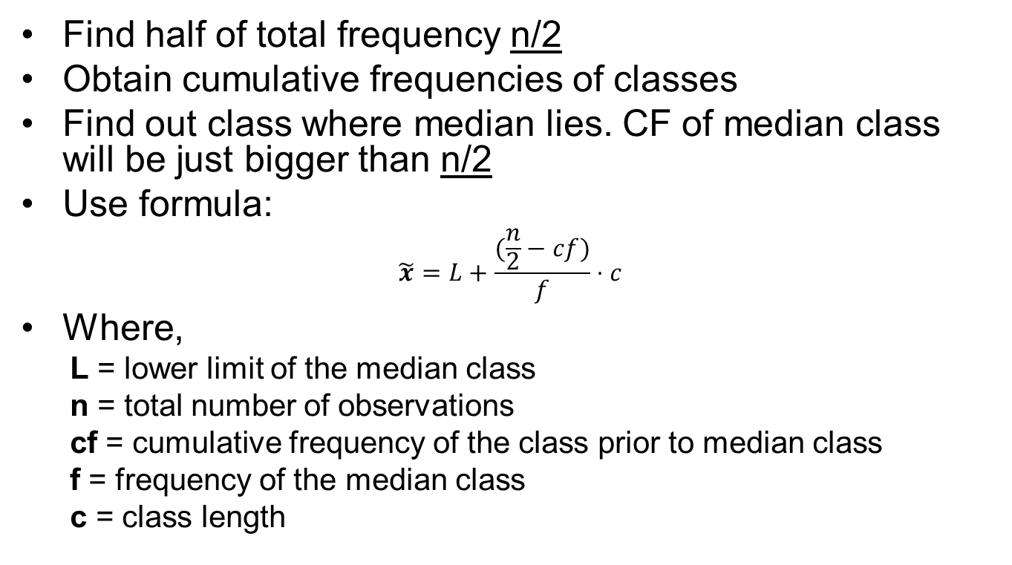
Median of grouped data
Find half of total frequency n/2
Obtain cumulative frequencies of classes
Find out class where median lies. CF of median class will be just bigger than n/2
Use formula:
$$\tilde{x}=L+\frac{(\frac{n}{2}−cf)}{f}⋅c$$
Where,
L = lower limit of the median class
n = total number of observations
cf = cumulative frequency of the class prior to median class
f = frequency of the median class
c = class length

Slide 49
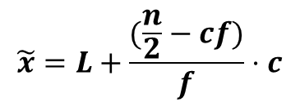
Median of grouped data
Example:
$$\tilde{x}=L+\frac{(\frac{n}{2}−cf)}{f}⋅c$$
Grades | Frequency
40-49 | 3
50-59 | 5
60-69 | 6
70-79 | 9
80-89 | 8
90-100 | 7
Σ | 38
cf
3
8
14
23
31
38
L = 70
n = 38
cf = 14
f = 9
c = 9
Median = 75
Median class: 70-79
(23 just bugger than 19)
n=38
n/2=19

Slide 50

Median of grouped data
Example (to do): A survey on random peoples yield the following data. Find out the median age.
n = Σf = 30
n/2=15
Median class = 41-50
$$\tilde{x}=L+\frac{(\frac{n}{2}−cf)}{f}⋅c$$
Age | Frequency
11-20 | 3
21-30 | 4
31-40 | 7
41-50 | 8
51-60 | 5
61-70 | 2
71-80 | 1
cf
3
7
14
22
27
29
30
L = 41
n = 30
cf = 14
f = 8
c = 9
Median = 42.125

Slide 51
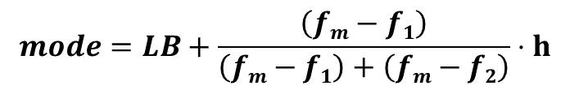
Mode of grouped data
Steps:
Obtain class boundaries.
Find out the class that has largest frequency. Call it mode class.
Use the formula:
Where,
LB = Lower class boundary of modal class
h = Class interval
f_{m}=frequency of modal class
f₁=frequency of class prior to modal class
f₂= frequency of class after modal class
$$mode=LB+\frac{\left(fm−f1\right)}{\left(fm−f1\right)+\left(fm−f2\right)}⋅h$$

Slide 52

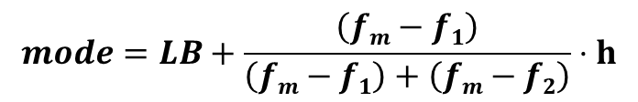
Mode of grouped data
$$mode=LB+\frac{\left(fm−f1\right)}{\left(fm−f1\right)+\left(fm−f2\right)}⋅h$$
Example
Height (inches) | Frequency
48-50 | 5
50-52 | 7
52-54 | 10
54-56 | 9
56-58 | 6
58-60 | 3
f₁=7
Modal class f_{m}=10
f₂=9
LB=52
h=2
$mode=52+\frac{(10−7)}{\left(10−7\right)+(10−9)}⋅$2
mode=53.5

Slide 53
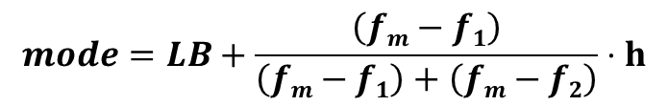
Mode of grouped data
Example: Following table shows the grades and their frequencies obtained by the students. Obtain the mode of grade
$$mode=LB+\frac{\left(fm−f1\right)}{\left(fm−f1\right)+\left(fm−f2\right)}⋅h$$
Grades | Frequency
40-49 | 3
50-59 | 5
60-69 | 6
70-79 | 9
80-89 | 8
90-100 | 7
Mode=77

